Slide 1
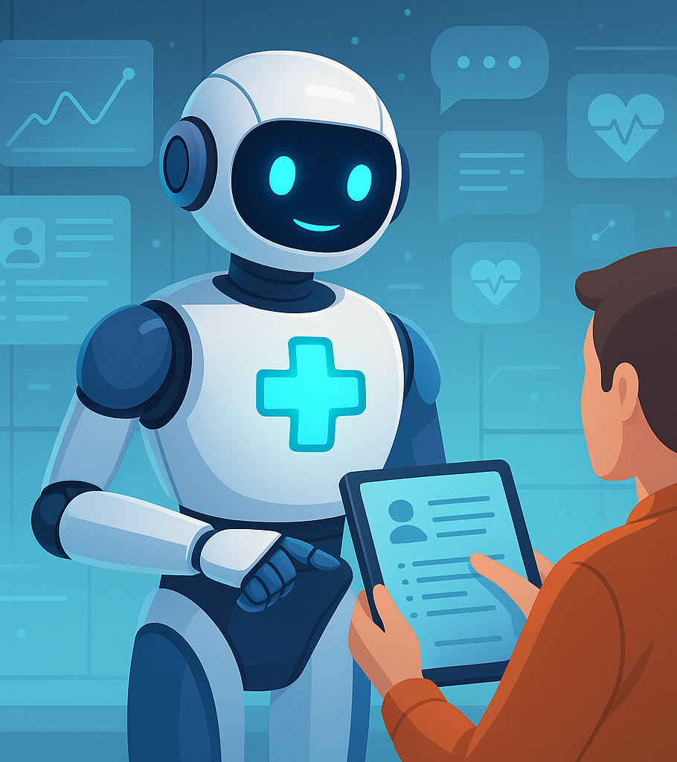
MEdBot User Friendly medical chatbot

Slide 2
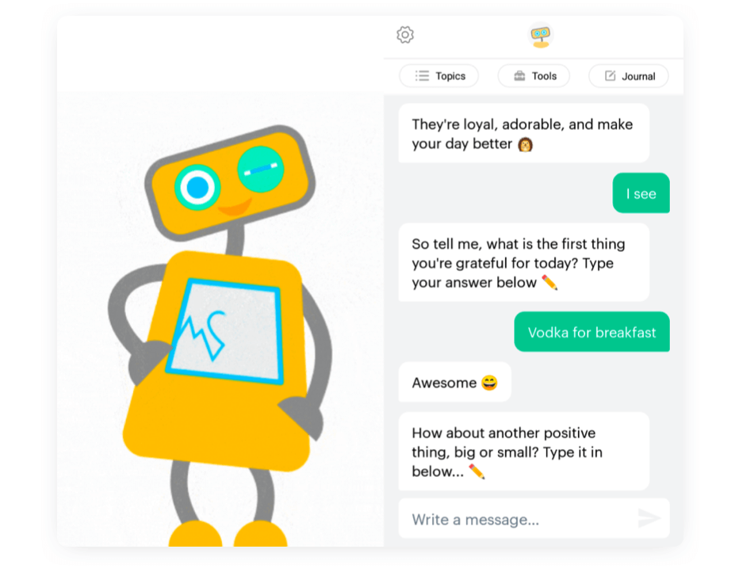
What is Chatbot?
A chatbot is a software application that mimics human conversation, allowing users to interact with it using natural language—either through text or voice. Built using Artificial Intelligence (AI) and Natural Language Processing (NLP), chatbots are commonly deployed in customer service, virtual assistance, and other interactive platforms to provide automated, real-time responses and streamline user engagement.

Slide 3
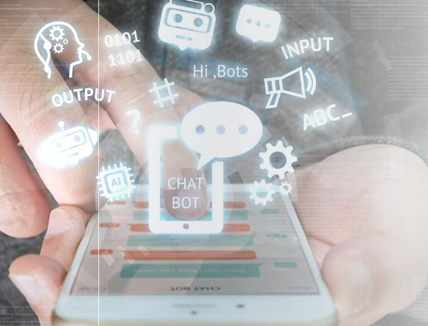
How Do Chatbots Work?
Chatbots work by processing user input through Natural Language Processing (NLP), which allows them to understand and interpret the meaning behind the words. Once the input is analyzed, the chatbot performs Intent Recognition to determine what the user is trying to accomplish—such as asking a question, greeting, or making a request. Based on the identified intent, the system then proceeds with Response Generation, where it produces a suitable reply using either trained machine learning models or predefined response rules.

Slide 4
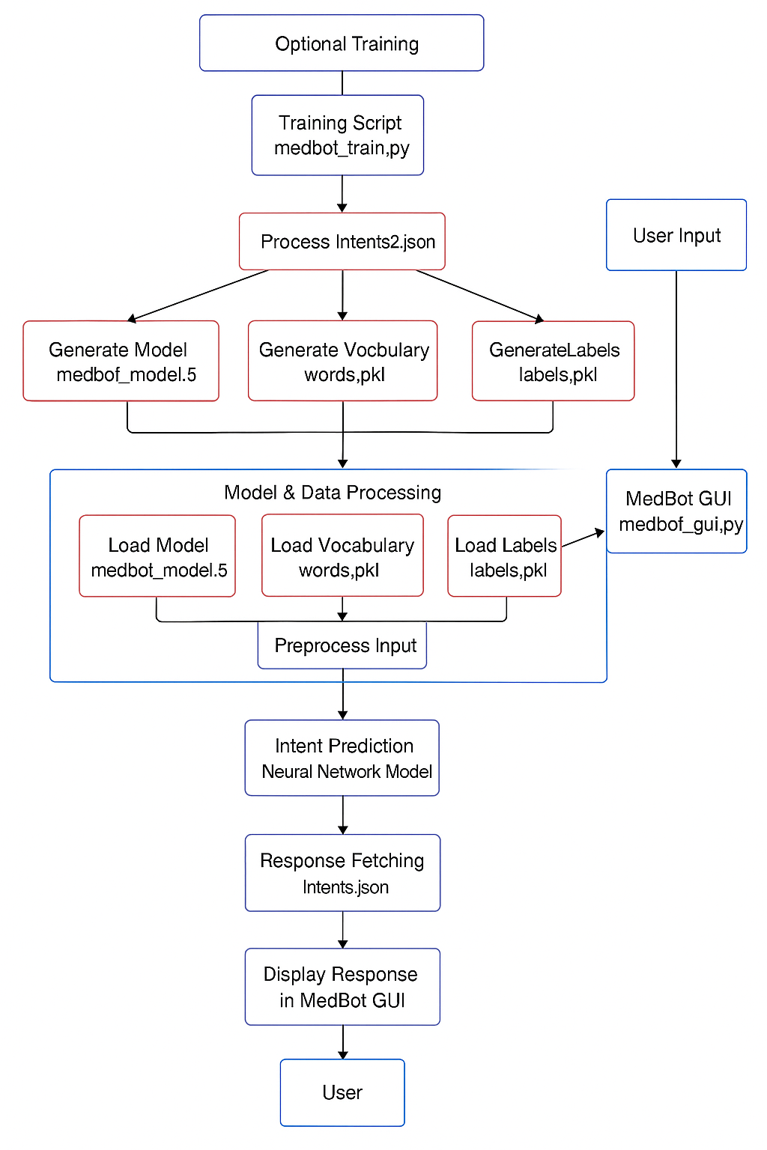
Architecture Diagram

Slide 5
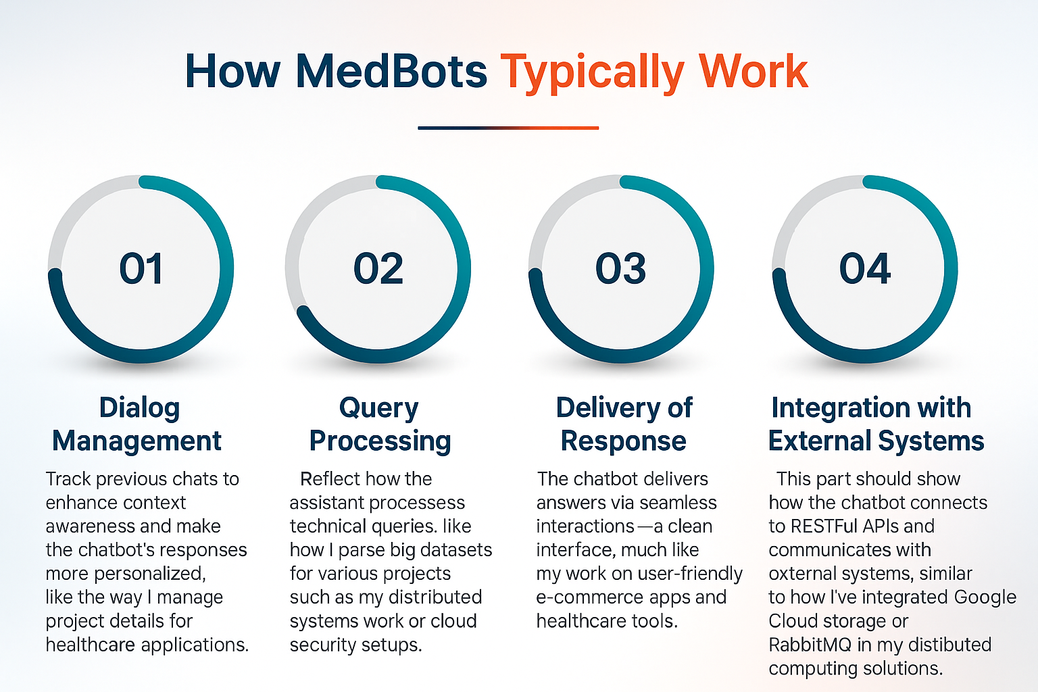

Slide 6
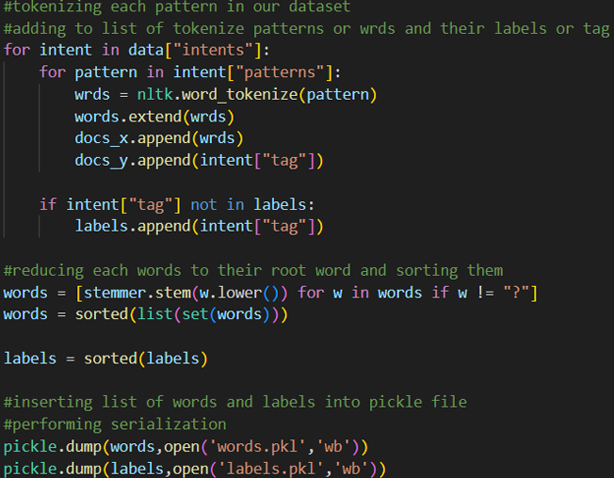
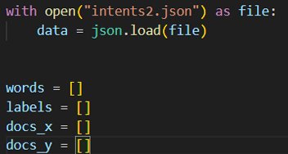
How Medbot Work

Slide 7
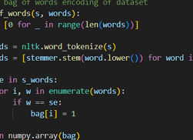
How medbot work
Load the intents file containing user input patterns and responses.
Tokenize each pattern to split sentences into individual words.
Apply stemming to reduce words to their root forms and sort them for consistency.
Create and insert lists of words and their corresponding labels.
Serialize the data using pickle files for later use in training and prediction.

Slide 8
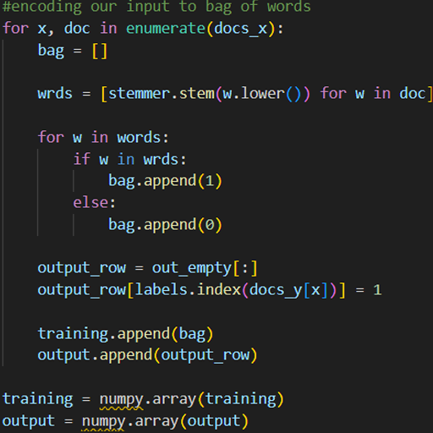
How medbot work
Bag-of-Words Encoding
Converts text data into numerical vectors for machine learning models.
Each word in the vocabulary is represented as a binary value:
1 if the word is present in the input,
0 if absent.
Tokenize and stem words from the user input to get root forms.
Create a binary vector by matching the processed input words against the vocabulary list.

Slide 9
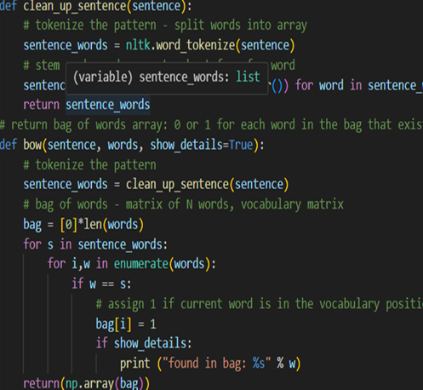
How medbot work
The code processes user input for text-based applications such as chatbots.
It tokenizes the sentence into individual words.
Then, it applies stemming to reduce words to their root forms.
A Bag-of-Words (BoW) vector is created from the tokenized input.
Each word in the predefined vocabulary is marked as:
1 if the word is present in the input,
0 if it is not.
This vectorized representation helps the chatbot match input to predefined patterns.
As a result, the chatbot can understand user queries and provide appropriate responses.

Slide 10
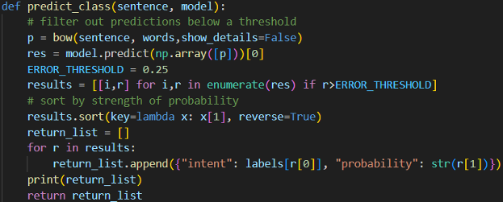
How medbot work
Large headline
The predict_class function takes a user input sentence as input.
It converts the sentence into a Bag-of-Words (BoW) vector.
The BoW vector is then passed through the trained model to generate predictions.
Predictions that fall below a specified confidence threshold are filtered out.
The remaining predictions are sorted by probability, from highest to lowest.
The function returns a list of predicted intents along with their confidence scores.
This helps the chatbot to accurately identify the user's intent and respond appropriately.

Slide 11
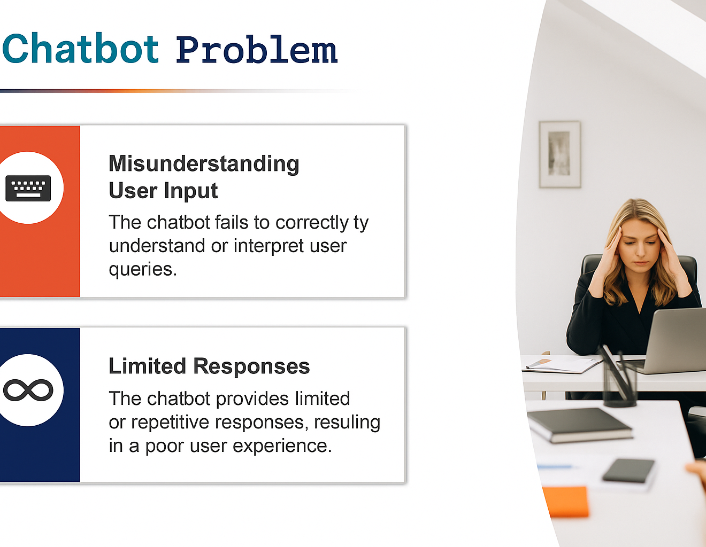
Misunderstanding User Input: Despite advancements in NLP, chatbots often struggle to correctly interpret user queries, especially when phrased in unexpected or informal ways.
Limited Responses: Chatbots can sometimes respond with generic or repetitive answers, limiting the depth of interaction and frustrating users expecting more dynamic conversations.
Lack of Context Awareness: Many chatbots fail to maintain conversation context, leading to broken or irrelevant replies during multi-turn interactions.

Slide 12
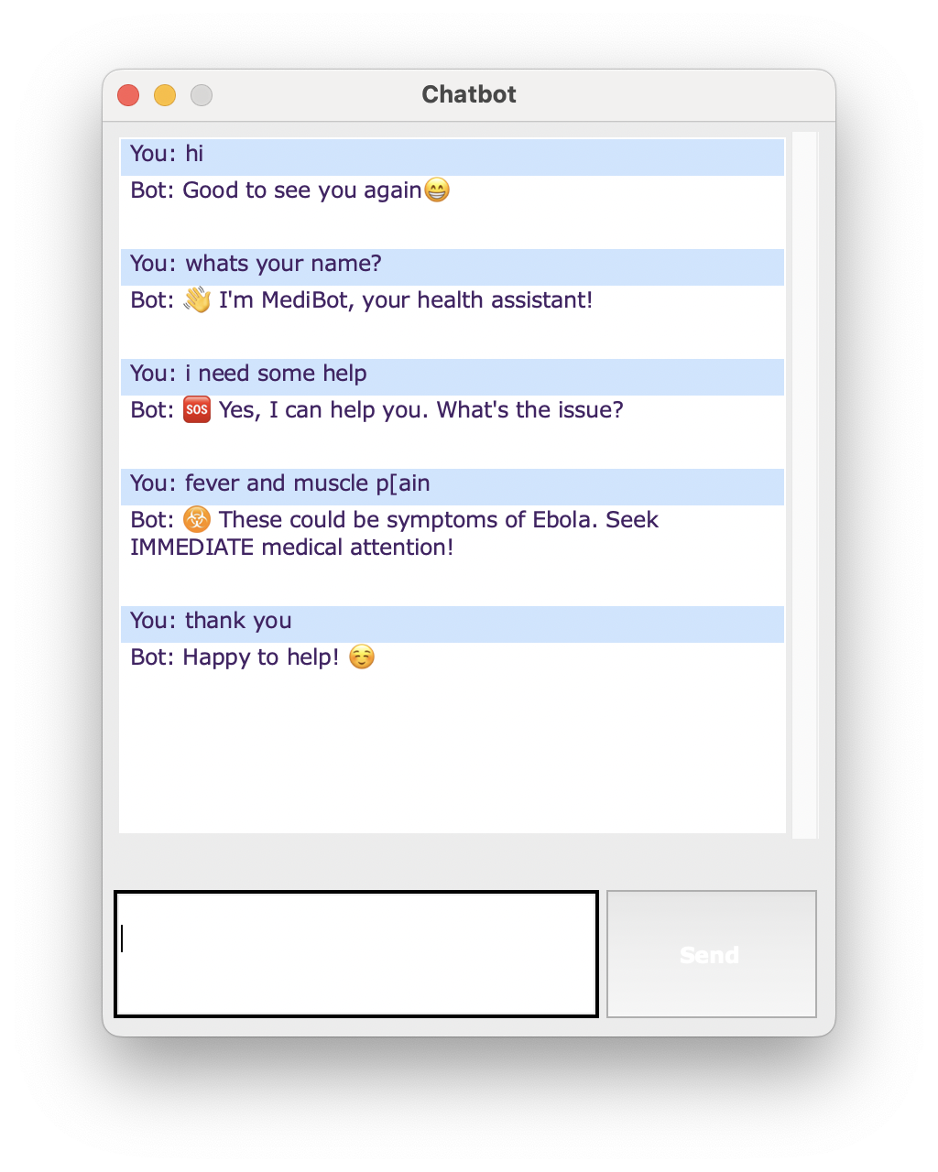
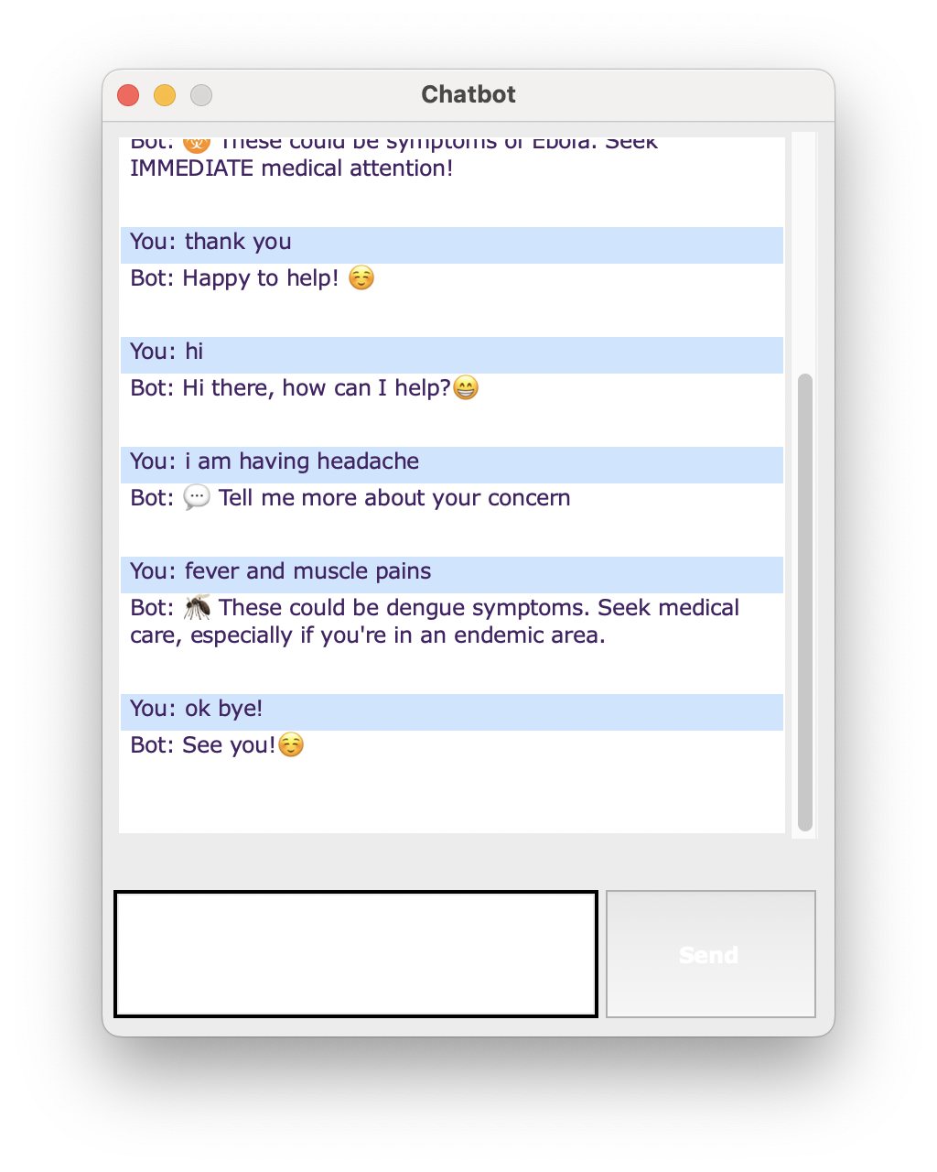
Results

Slide 13
Conclusion
MedBot successfully classified user inputs into predefined intents and generated relevant responses in real time using a neural network trained on Bag-of-Words vectors. The structured methodology—covering data preprocessing, model training, and response generation—ensured reliable performance for basic healthcare-related queries. Moving forward, MedBot can be improved by expanding the dataset and incorporating advanced NLP techniques to handle more complex medical conversations and maintain better context awareness.

Slide 14

Presented by
Jahnavi Redrouthu –16361448
Raj Kumar Bandi -16361456
Balaji Malisetti -16354258
Rakesh Babu Macharla -16363180

